Slide 1
Git for Infra

Slide 2
Objectives
Understand why you should learn git
01
Learn scenarios
02
Start using git in day-to-day work
03

Slide 3
Agenda
Introduction
Creating a repository

Slide 4
Why Git (For Infra)?
Manage your own code
Sync your code with different devices (laptop + desktop + dev server on azure)
Better management experience with specific commands instead of copy file (commit, fetch,push, pull merge etc)
Syncing remote is optional
Share your Code
Manage access public / private
Everyone Stays up-to-date
Requirement for IAC DevOps integration
Arm (json)
Terraform (Json / Hcl)
Yaml
XML
Advanced Azure Scenarios
Azure Automation: Runbook version control
AKS: deployments & Version Control
Azure Functions: Deployments
Azure Policy: Azure Policy As Code & Build a lifecycle
Many other services.. (Data Factory, Azure sql and so…)

Slide 5

Git Story
Initial Release 2005
Author: Linus Torvalds
Main purpose: Many developers can safely and easily manage Linux kernel code offline and online
Multiple devs works on same code
Easily solve conflicts
Work online or offline
Modern features to manage branches/layers

Slide 6
Git is not Github
Git
version control system (a standard not a service)
Github, Gitlab, Azure Repos (Azure Devops), Jira, Bitbucket
They are services providing git version control system
They all work same only bit minor management differences
Once you Learn Git they all look the same
Set of commands (commit, push, pull, sync, init, fetch, merge , checkout and many more)

Slide 7
Which Service to Choose?
Price
Additional Features
Github pages
Issue Management
Colloboration
Wiki
Devops Pipeline Integration
Azure Pipelines
Github Actions
Jenkins
Popularity
Important for Self Marketing
Reach to broader target audience

Slide 8
Git Fundementals
Repository (Repo) - Root Container
Works as project root folder
Contains all the code and doc and etc to manage
Intialized by “git init”
Local repo (PC) or Remote repo (Github) (they are usually linked and synced)
Git tracks all filesystem changes in the repo/folder
Once you make a change(save) then you manage the change (commit, discard .etc)
Version Control is based on commits
Save is not enough!!!

Slide 9
Requirements
A computer for development
Git for Windows (git client)
Visual Studio Code (vscode)
A Shell (I use PowerShell)
An account in Github to host and sync with Remote
Any Service will work, this tutorial focuses on most popular one ☺

Slide 10
Configuring Git Client
Initial configuration requires
Setting username and email (Global or Per Repo) to attach to commits
Additional config if proxy is required
git config --global user.name "John Doe"
git config --global user.email johndoe@example.com
# below line is only required if you are using a proxy server with no authentication
git config --global http.proxy http://proxy.server.com:port
# If the proxy requires authentation using ntlm authentication
git config --global http.proxy http://:@proxy.server.com:port
git config --global verifySSL false

Slide 11
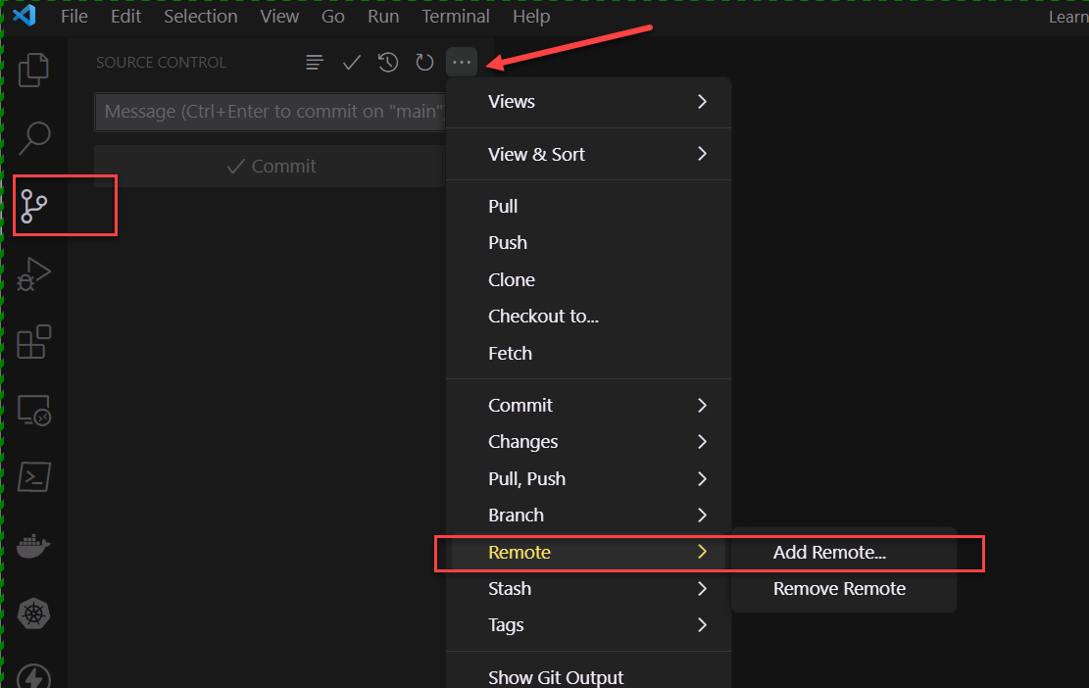
Hint
Terminal Experience
You can use git commands and mange your code in terminal
VSCode – Gui Experience
Source control tab enables you to use most of the commands as a gui experience

Slide 12
Demo 1
Start using Git: Configure Git Client and Vscode

Slide 13
Creating a repo
Option 1: You can create a remote repo and then clone to your local development computer
Create remote Repository
Get the clone link
Clone Repository
Option 2: Start on your development computer as a local repo and then push to remote
create a folder and init as a repository on local computer
Crate a remote repository
Get clone link
Set the link on local computer to local repository
Push to remote

Slide 14
OPTION 1 - Create a Remote Repo and Sync
My go-to choice

Slide 15
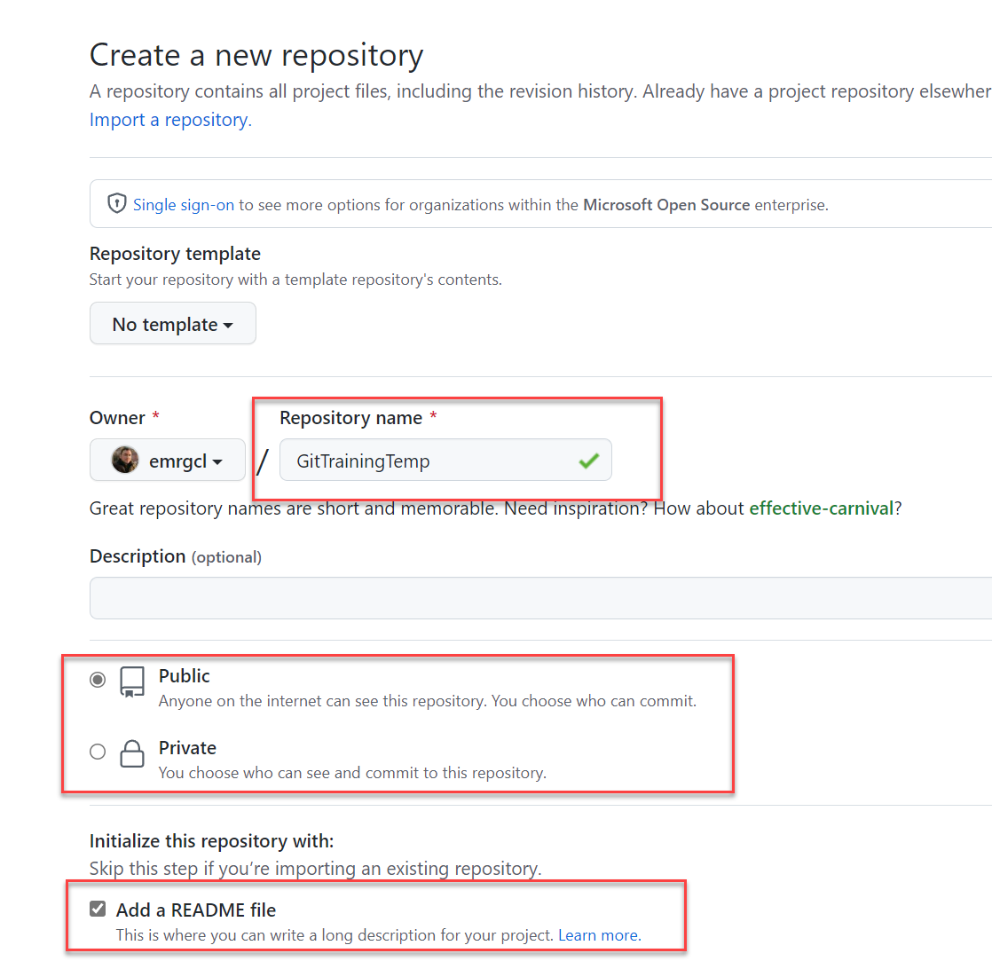
Create your first repo in Github
First create an account (in this case emrgcl)
Create a repo with
Name
Choose Access type
Optionally and in most cases add a readme file
This is your Remote Repo

Slide 16
Welcome to Markdown! Readme.md
Works like index.html of repo
Uses Markdown language
Industry standard for documentation
Very easy to learn
Documentation as Code: Develop code and content in separate files with same tool (Vscode)
Create as many markdown files as needed for additional documentation
Many of the services also has Wiki option to manage and naviagate markdown files.

Slide 17
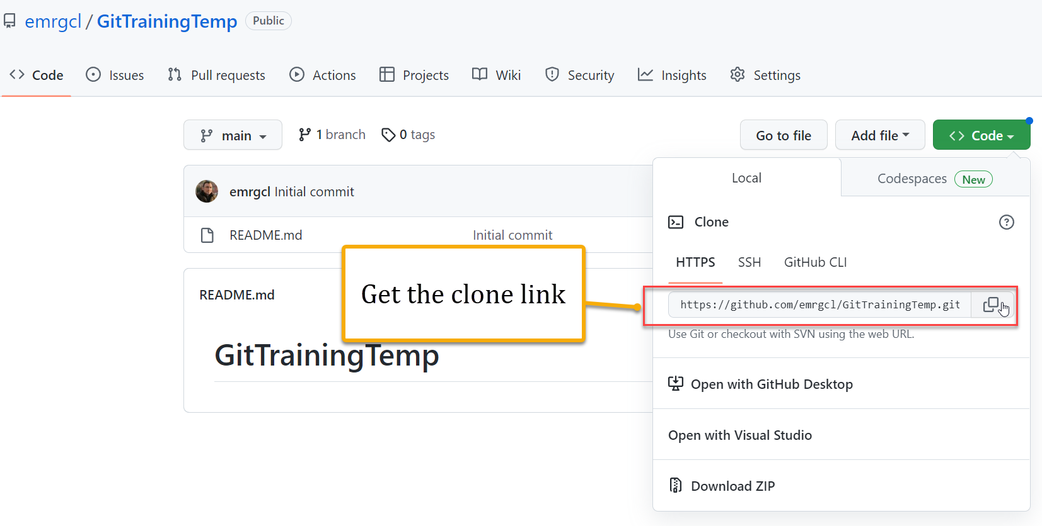
Get the clone link
To clone locally we need the link

Slide 18
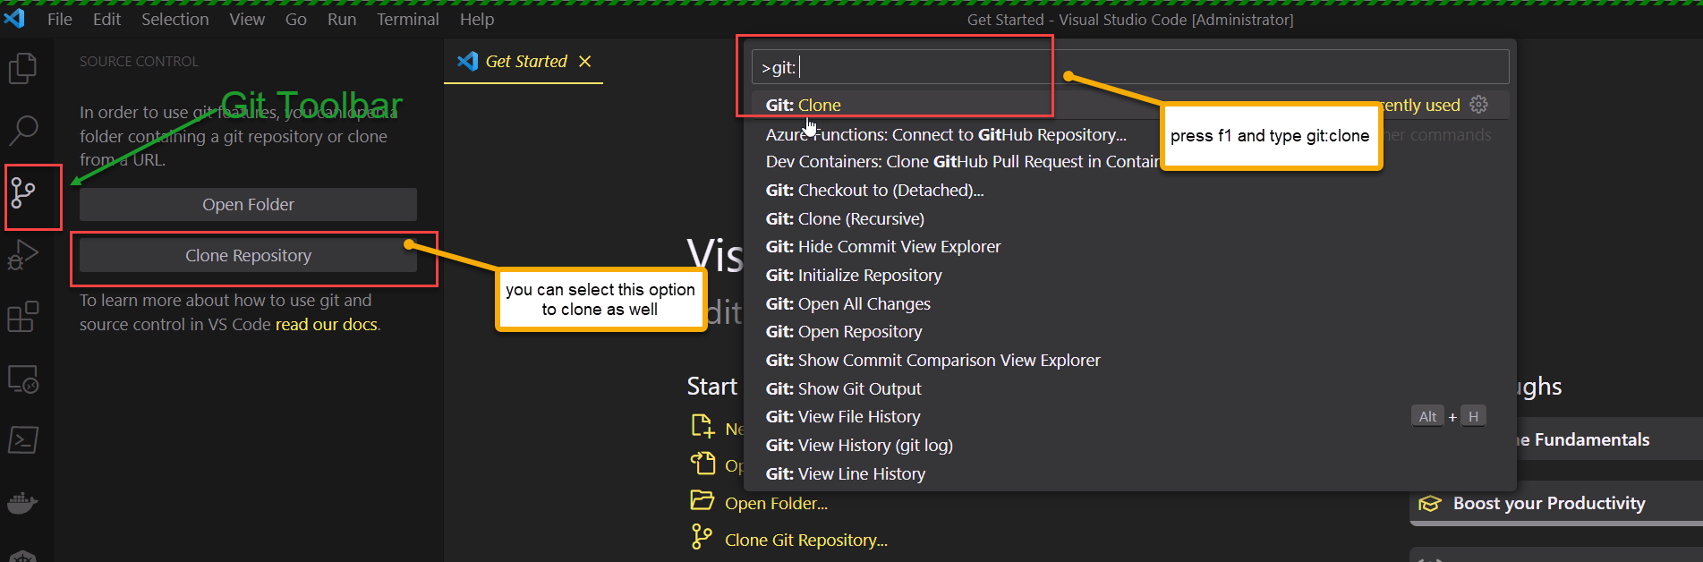
Get the remote repo to local / Clone
You can use
Gui
Command line
git clone https://github.com/emrgcl/LearnGitTest.git

Slide 19
Demo 2
Start using Git: Create a remote repo and sync

Slide 20
OPTION 2 - Create local Repo and Sync with Remote
I Don’t prefer this much

Slide 21
High Level Steps
Create a local Repository
Git init –b main
Create Remote Repository
Get the remote Repository link
Link the Repositories
Push
(--set-upstream once)

Slide 22
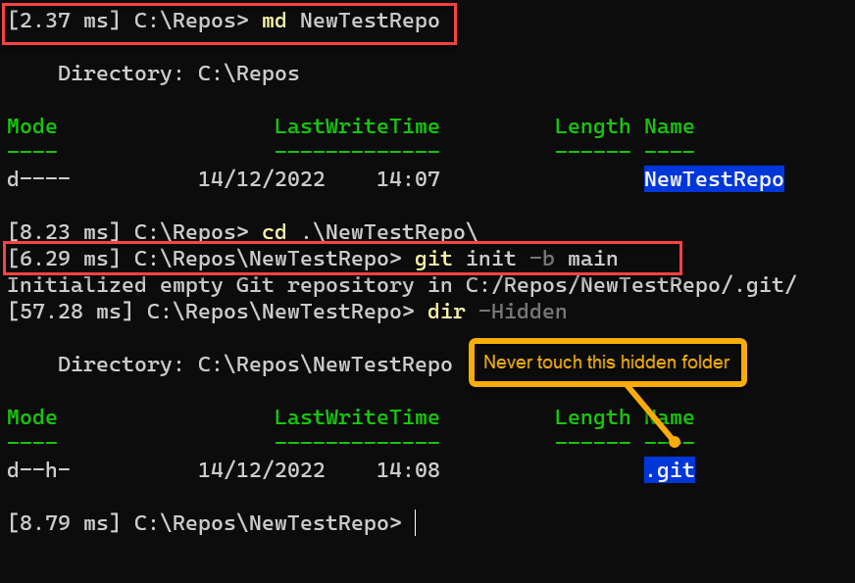
Create your local Repository
Create an empty folder
Initiliaze the folder using “git init as a repository

Slide 23
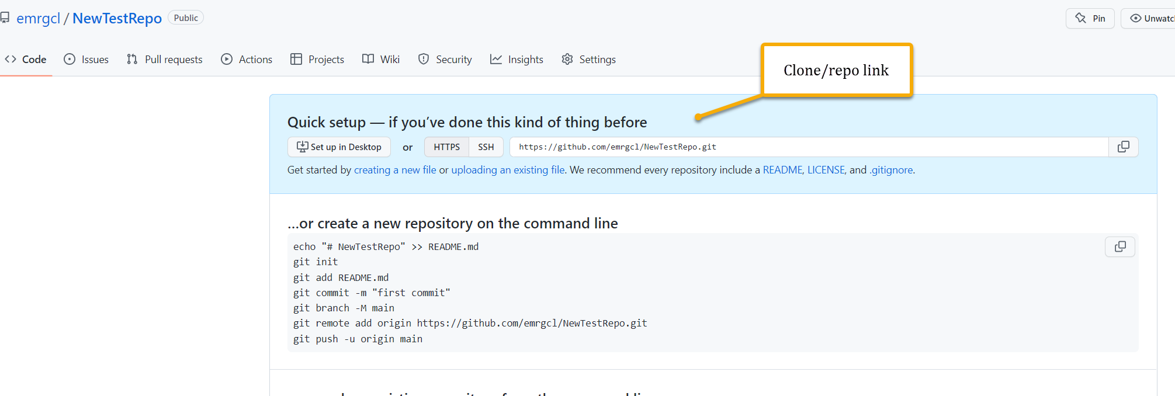
Create Remote Repository and Get Link

Slide 24
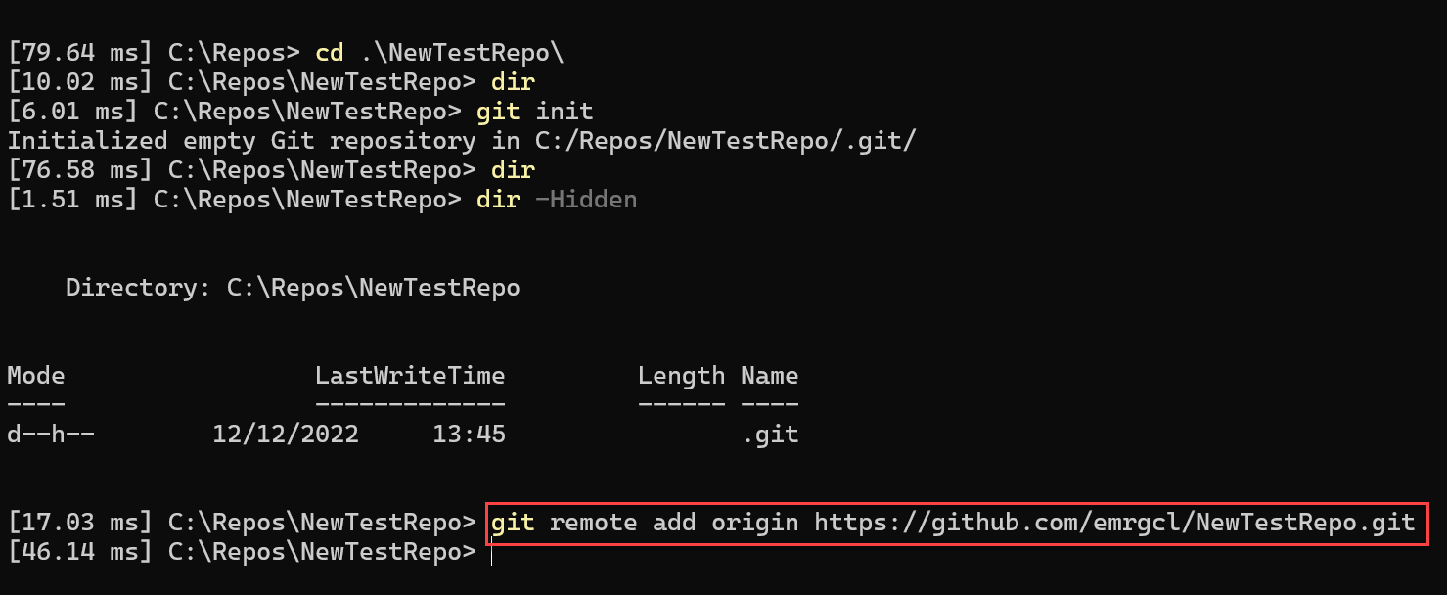
Link local repo with Remote
Terminal
VSCODE

Slide 25
Demo 3
Start using Git: Create a local repo repo and sync with Remote

Slide 26
Section Summary
There are two repos local and remote
They need to be linked
Clone makes it easy to kick start project with less steps
All commands can be run either in console or vscode using the gui options

Slide 27
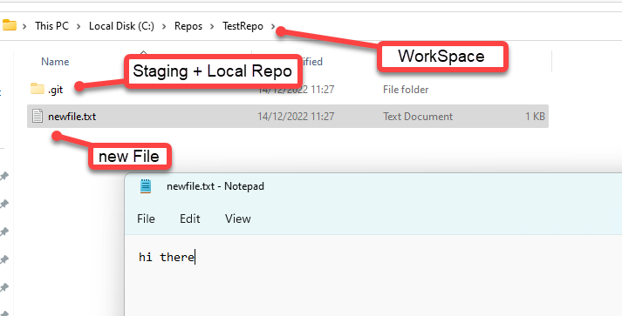

Add your first file to Repository
Remote Repo
CommitID
Newfile.txt
push
G
Local Computer
Workspace (Working Folder)
Staging Area
Local Repo
Newfile.txt
Newfile.txt
CommitID
Newfile.txt
add
commit
GitMan

Slide 28
Git commands used in adding/updating / pushing
Action | Git Command
Add all new files to staging | Git add –all or git add .
Remove a file | Git rm ‘filename’
Commit all changes (not newly added) | Git commit –a –m “Added new Files”
Push | git push origin main
remote
branch

Slide 29
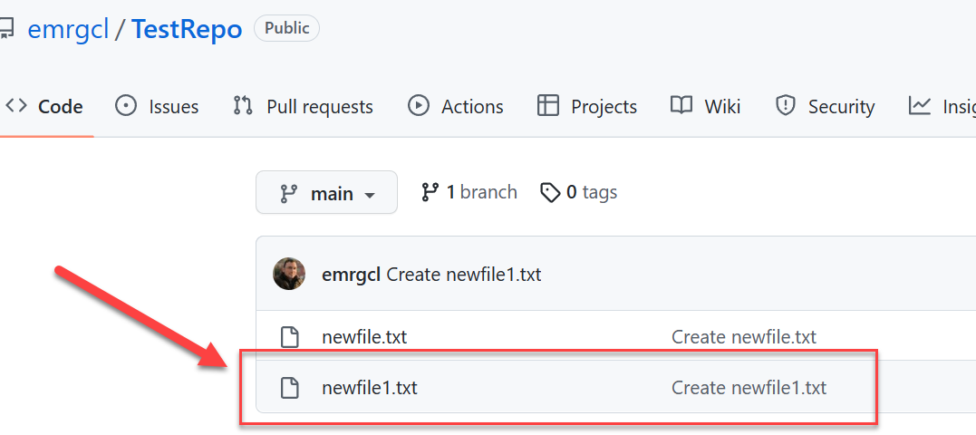
Syncing Back
Remote Repo
CommitID
Newfile1.txt
Fetch
G
Pull = Fetch + Merge
Local Computer
Workspace (Working Folder)
Local Repo
Newfile.txt
CommitID
Merge
Newfile1.txt
Newfile1.txt
GitMan

Slide 30
Git commands used in syncing, pulling
Action | Git Command
Add all new files to staging | Git add –all or git add .
Remove a file | Git rm ‘filename’
Commit all changes (not newly added) | Git commit –a –m “Added new Files”
Push | git push origin main
remote
branch

Slide 31
Introduction to Branches
Are used to Isolate Changes making easier to colloborate
Allows multiple features bugfixes to worked on without interfering each.
Key Concepts:
Central branch (master / main): Created by default
Feature/BugFix Branch: Specific branch that represents tasks or features. Created as necessary.
Merging is the process of integrating changes from one branch into another
Checkout: Switching between branches

Slide 32
Working with branches
Initialize
Initialize the Repository: init or Pull
Create
Create a local your branch and Checkout
Make changes
Do your changes and commit them to the current branch
Link and push
Link and push changes to remote.
Merge
Merge your working branch into main

Slide 33
Creating and Switching Branches
Action | Git Command
Creating a new branch | Git checkout –b <branch_name>
Switch between branches | Git checkout <branch_name>
List All Branches (Local and Remote) | Git branch -a
List local branches only | Git branch
List remote branches only | Git branch -r

Slide 34
Linking and Pushing Changes
Action | Git Command
Publish your local branch | Git push –u origin <branch_name>
If you need to get a remote branch to local;
Fetch the Remote Branch first | Git fetch origin <remote_branch_name>
Link your local (current branch) with remote one | Git chechout –b <local_branch_name> origin/<remote_branch_name>
List your remote repositories | Git remote -V

Slide 35
Merging into Main and Resolving Conflicts
Fetch
Fetch the latest changes from remote
Switch
Switch to main branch (merge will happen on the target branch)
Merge
Merge your changes `git merge <branch_name>`
Handle
Handle merge conflicts if any `git status`
Fix
Fix the conflicts in editor and `git add <file_name>`
Commit
Commit merged changes `git commit –m ‘merge <branch_name into main>’
Push
Push changes `git push origin main`
Merge Fixes
Merge the commit with fixes `git merge <branch_name>`

Slide 36
Issues with Merge
Is anyone aware about the change?
What is the collaboration method/tool ?
Do you require approval before merge ?

Slide 37
Pull Requests instead of Merge

Slide 38
Enforcing Pull requests

Slide 39
Working with History
Helps Reviewing History
`Git log` shows commit history of the current checked out branch
Versatile filtering options
Has various filter options to figure out changes done particular author, date range or file.
Helps reviewing with visualizations
Can generate graphical visualization

Slide 41
Common git log commands
Action | Git Command
Simple list of commits with basic info | git log
A compact list with descriptions | git log --graph --oneline --decorate
Commits done by specific author | git log --author="Author Name"
Commits done in a specific date range | git log --since="1 week ago" --until="yesterday"
Find updates made to a file | git log --pretty=format:"%h - %an, %ad : %s" -- path/to/your/file

